Slide 1


Spatial Transcriptome with R programming
2023 The 19th KOGO Winter Workshop
2023. 2. 1. Wed
Choi Lab
Korea University College of Medicine

Slide 2
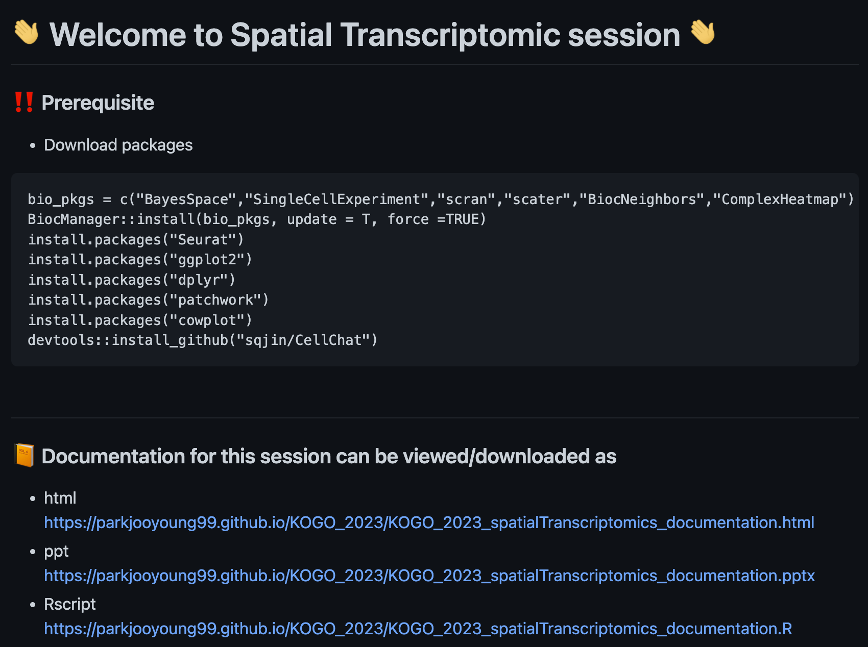

Welcome to Spatial Transcriptomic session
Please visit our github repository for the workshop : https://github.com/parkjooyoung99/KOGO_2023
Please download R packages for the session
You can access to the R markdown
You can download power point slides
You can download R script to be used in this session

Slide 3
Table of Contents
What is R programming?
Space Ranger
Clustering Analysis – BayesSpace
Cell-cell interaction – CellChat
Summary
Q&A

Slide 4
What is R programming?
1

Slide 5



What is R and Why R?
R is used widely in biological research and provides a solid platform for beginner scientific programmers.
Many graphing and statistical operations are built right into the language.
It’s free and open-source.
It runs on all major operating systems.
R is the most common statistics platform in genomics and easy to use.
Bioconductor uses the R statistical programming language and is open source and open development.
Modified from : https://datacarpentry.org/semester-biology/about/why-r/
https://www.bioconductor.org/

Slide 6
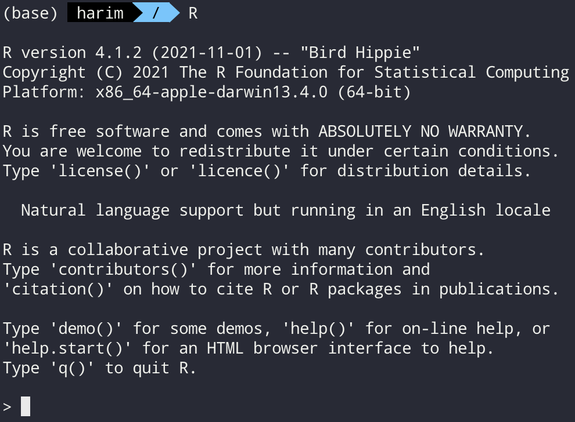
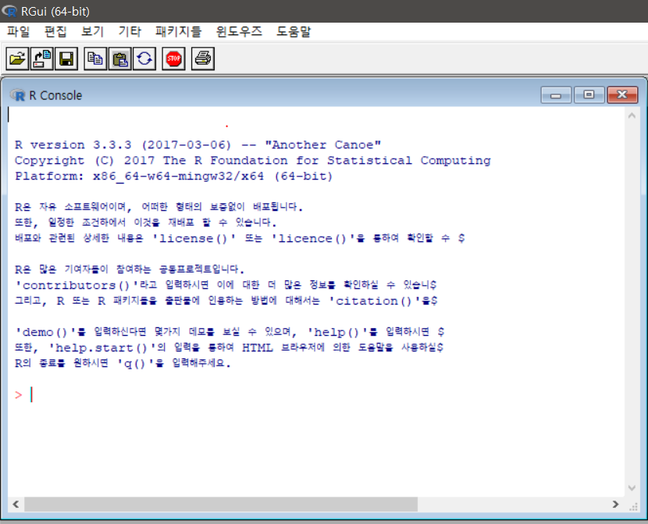
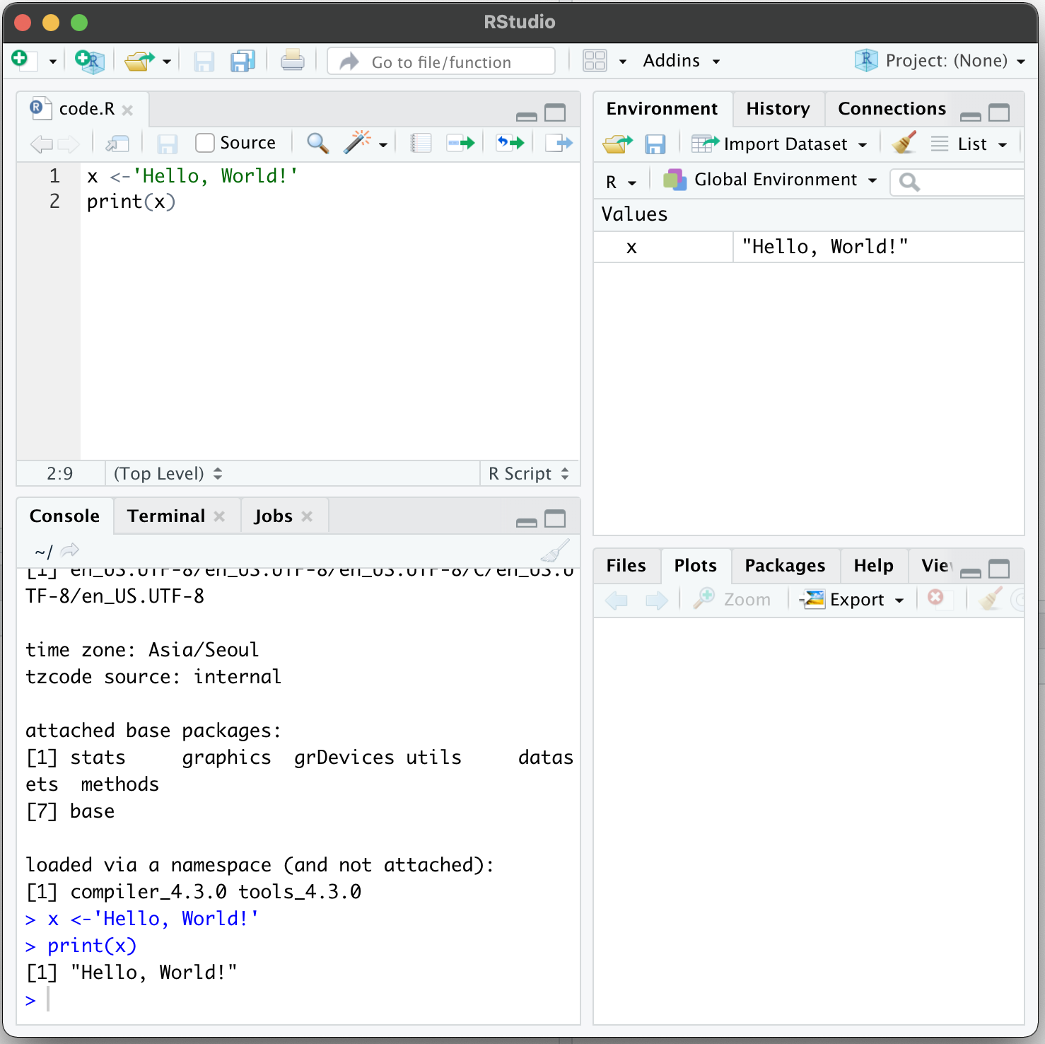
Several ways to use R
Command line
Graphical user interface
Rstudio

Slide 7
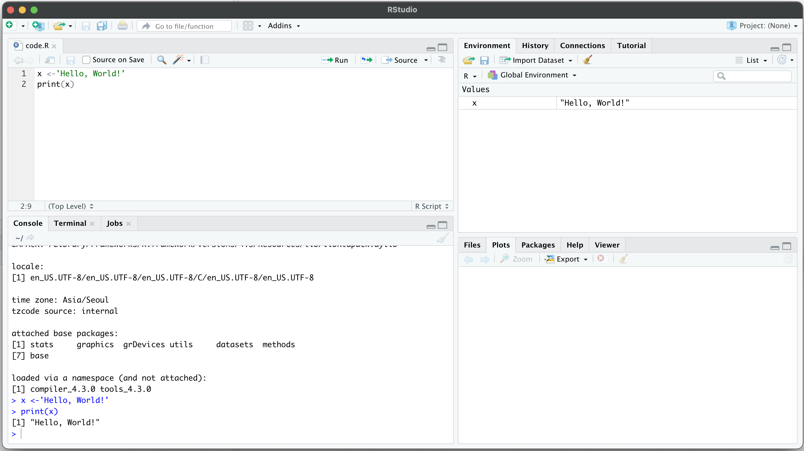
Rstudio
Rstudio – Integrated development environment (IDE) for R and python
Code editor에서 코드를 작성하거나 적혀져 있는 코드를 실행합니다.
Ctrl+Enter를 통해 각 한 줄씩의 코드를 실행할 수 있습니다.
Code editor
Environment / History
R console
Other panes
(Files, Plots, Packages, Help)

Slide 8
Space Ranger
2

Slide 9
What is Space Ranger?
Space Ranger is a set of analysis pipelines for processing 10X Genomics Visium sequence data (FASTQ files) with high resolution microscope images of tissue.
It maps the transcriptomic reads to the microscope image of the tissue from which the reads were obtained
We will introduce spaceranger count pipeline among the 5 pipelines

Slide 10
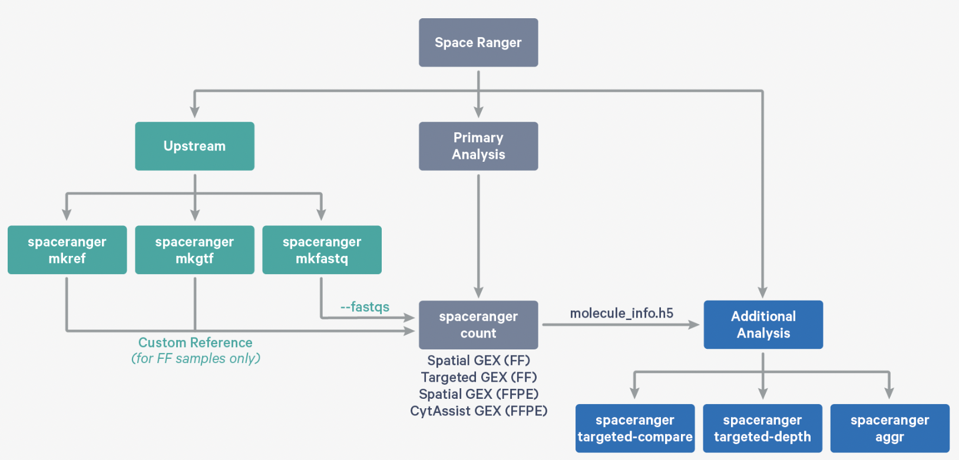
Space Ranger Pipelines
spaceranger mkfastq
spaceranger count
spaceranger aggr
spaceranger targeted-compare
spaceranger targeted-depth
https://support.10xgenomics.com/spatial-gene-expression/software/pipelines/latest/what-is-space-ranger

Slide 11
Installing Space Ranger
Download and unpack the Space Ranger .tar.gz file in any location
Download and unpack proper reference data .tar.gz file in a convenient location
3. Pre-pend the Space Ranger directory to your $PATH
$cd /opt
$tar -xzvf spaceranger-2.0.0.tar.gz
$tar -xzvf refdata-gex-GRCh38-2020-A.tar.gz
$export PATH=/opt/spaceranger-2.0.0:$PATH
https://support.10xgenomics.com/spatial-gene-expression/software/pipelines/latest/installation

Slide 12
Run spaceranger count command
$cd /home/jdoe/runs
$spaceranger count --id=sample345 \ #Output directory
--transcriptome=/home/jdoe/refdata/GRCh38-2020-A \ #Path to Reference
--fastqs=/home/jdoe/runs/HAWT7ADXX/outs/fastq_path \ #Path to FASTQs
--sample=mysample \ #Sample name from FASTQ filename
--image=/home/jdoe/runs/images/sample345.tiff \ #Path to brightfield image
--slide=V19J01-123 \ #Slide ID
--area=A1 \ #Capture area
--localcores=8 \ #Allowed cores in localmode
--localmem=64 #Allowed memory (GB) in localmode
https://support.10xgenomics.com/spatial-gene-expression/software/pipelines/latest/using/count
Input : the microscope image (.tiff), FASTQ files(Fastq)
Perform : sequence alignment, tissue detection
Output : gene-spot matrix

Slide 13
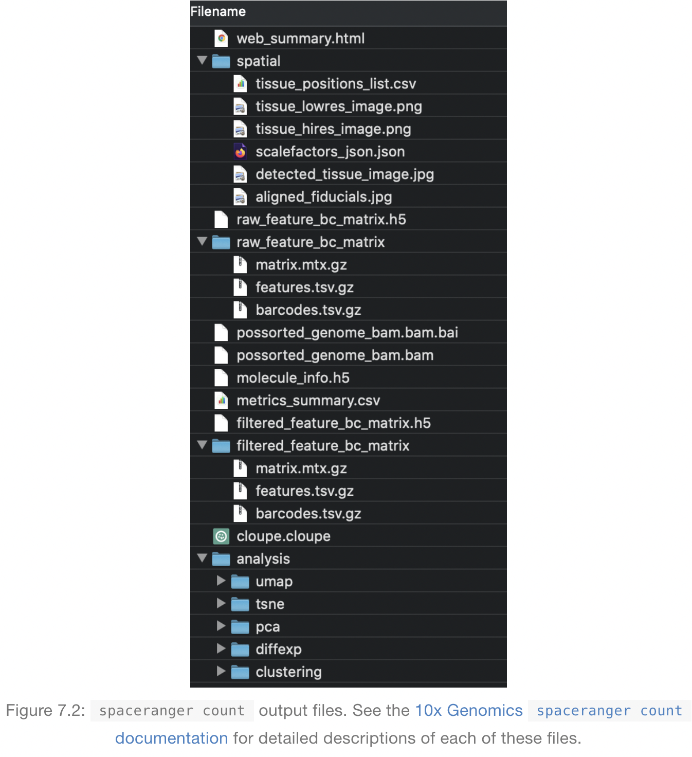
Output files of Space Ranger
read10XVisium Input files
https://lmweber.org/OSTA-book/space-ranger-visium.html

Slide 14
Output files
raw_feature_bc_matrix
Dataset having spots that theoretically don’t overlap with tissue
filtered_feature_bc_matrix
Dataset filtered to the spots overlapping tissue, as determined by Loupe Browser
(Visium) alignment file
tissue_positions_list.csv
The spot coordinates information is stored
scalefactors_json.json
Scaling factors that convert spot coordinates to pixel coordinates
metrics_summary.csv
Metrics displayed in the interactive website
web_summary.html
Interactive website

Slide 15
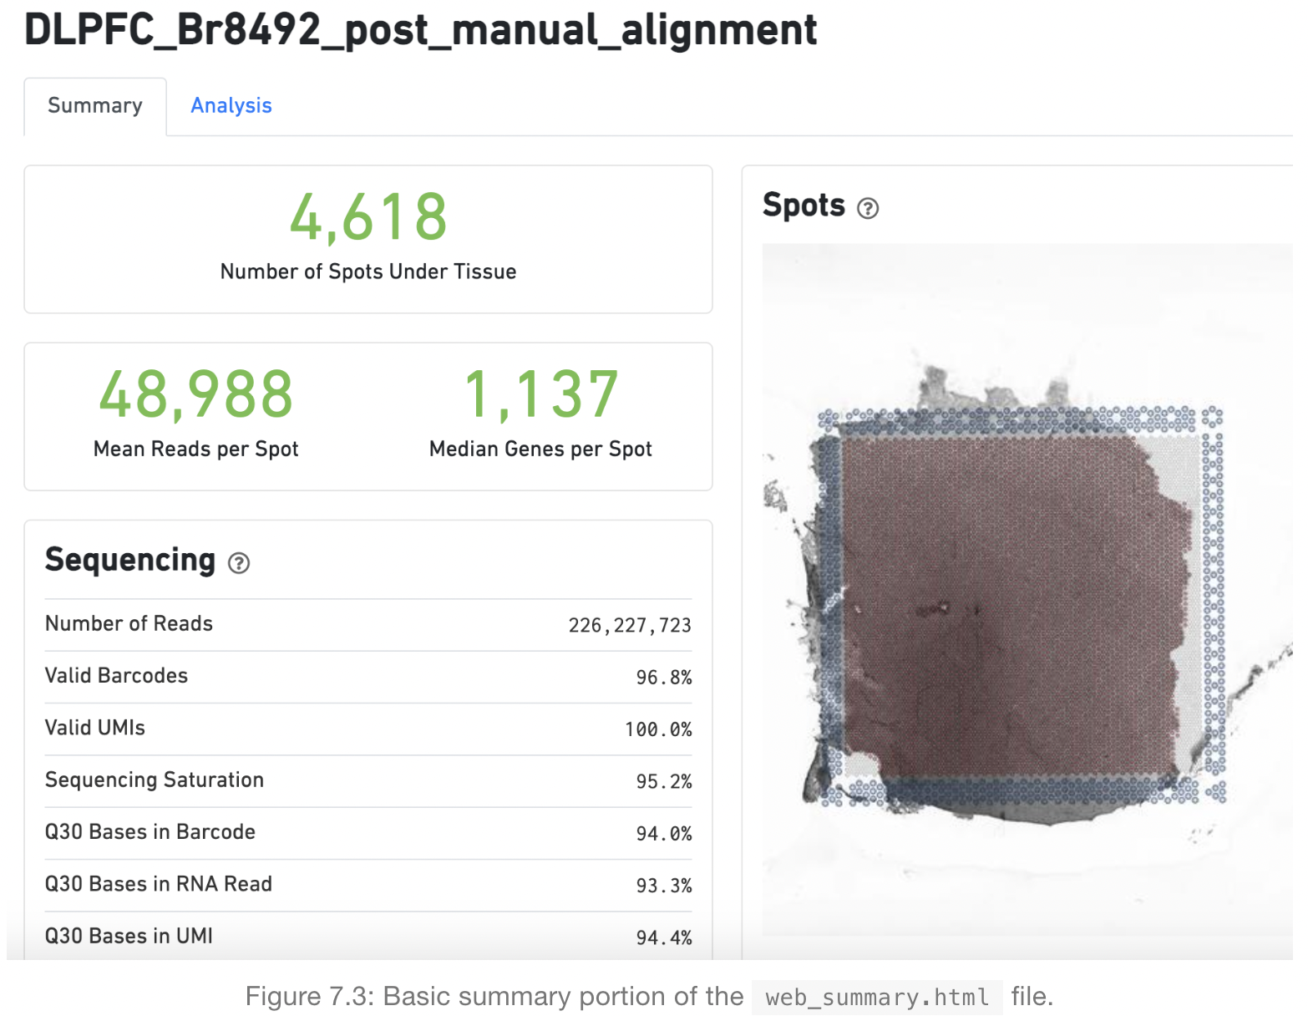
Web summary .html file
https://lmweber.org/OSTA-book/space-ranger-visium.html

Slide 16
Web summary .html file
Metrics | Definition | Expected/Recommended Value
Number of Spots Under Tissue | The number of barcodes associated with a spot under tissue.
Mean Reads per Spot | The number of reads, both under and outside of tissue, divided by the number of barcodes associated with a spot under tissue. | Recommended: 50,000
Median Genes per Spot | The number of reads under tissue divided by the number of barcodes associated with a spot under tissue. | Vary by sample, and low values are not necessarily indicative of a failed experiment
Number of reads | Total number of read pairs that were assigned to this library in demultiplexing. | Fresh frozen libraries: a minimum of 50k FFPE v1 libraries: a minimum of 25k
Valid Barcodes | Fraction of reads with barcodes that match the whitelist* after barcode correction | Expected >75%
Valid UMIs | Fraction of reads with valid UMIs i.e. UMI sequences that do not contain Ns and that are not homopolymers | Expected >75%
Sequencing Saturation | The fraction of reads originating from an already-observed UMI. This is a function of library complexity and sequencing depth | Dependent upon sequencing depth and sample complexity (at last 60-80 % in most applications)
Q30 bases in barcode, Sample Index, or UMI | Fraction of tissue-associated barcode, Sample Index, or UMI bases with Q-Score >= 30, excluding very low quality/no call (Q≤2) bases from the denominator | Sequencing platform dependent (Most Illumina runs generate >70-80% Q30 data)
https://lmweber.org/OSTA-book/space-ranger-visium.html

Slide 17
What is a Loupe Browser?
Loupe Browser is a desktop application from 10x Genomics that allows to visualize gene expression data without having to write code
Manual alignment of images
Align gene expression spots to histological images, look for marker gene expression, annotate populations, and cluster
The .cloupe file is the one that need to import into the Loupe Browser in order to explore the processed data. These files are generally between 1 and 2 GB each.

Slide 18
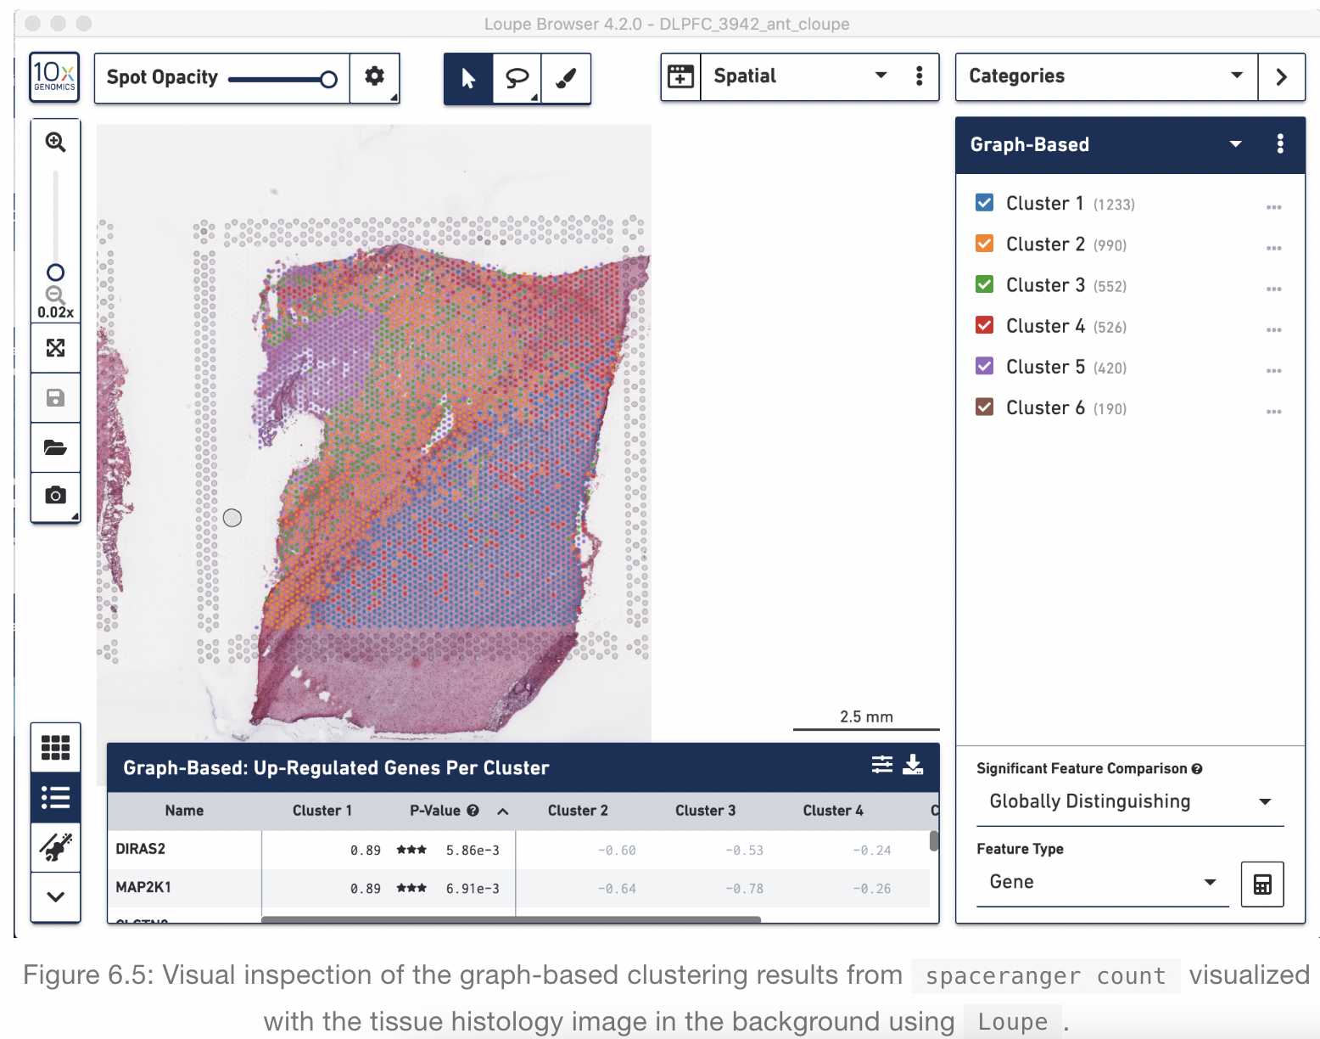
Loupe Browser
Histology image &
UMAP & t-SNE
Manual Annotation of spots
https://support.10xgenomics.com/spatial-gene-expression/software/visualization/latest/analysis

Slide 19
Load a 10X Visium dataset in R as a SinglecellExperiment
Creating sce object with one line code
sce = readVisium("path/to/spaceranger/outs/")

Slide 20
Clustering Analysis - BayesSpace
3

Slide 21
What is BayesSpace?
BayesSpace is an useful tool to conduct Spatial clustering analysis
It also provides a method to enhance the resolution of each spot by generating subspots
Zhao E, Stone MR, Ren X, et al. Spatial transcriptomics at subspot resolution with BayesSpace. Nat Biotechnol. 2021;39(11):1375-1384. doi:10.1038/s41587-021-00935-2

Slide 22
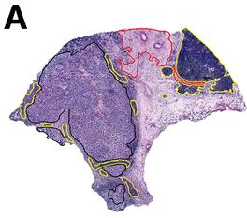
Dataset Description
For convenience, we will use ST Visium dataset generated from one of the melanoma samples originally reported by Thrane et al. (2018)
Figure 3A.
melanoma (black), stromal (red), and lymphoid (yellow) tissue regions.

Slide 23
0. Load packages in current R environment
1. Load data
2. Preprocessing
3. Feature selection / Dimension reduction
4. Clustering
5. Annotation
invisible(lapply(c(bio_pkgs,'dplyr','Seurat','ggplot2','patchwork’,’cowplot’), function(x) library(x, character.only=TRUE)))
set.seed(1234)

Slide 24
1. Load dataset
1. Load data
2. Preprocessing
3. Feature selection / Dimension reduction
4. Clustering
5. Annotation
Load prebuilt dataset
melanoma = getRDS(dataset="2018_thrane_melanoma", sample="ST_mel1_rep2")
same with
melanoma <- getRDS(dataset="2018_thrane_melanoma", sample="ST_mel1_rep2")

Slide 25
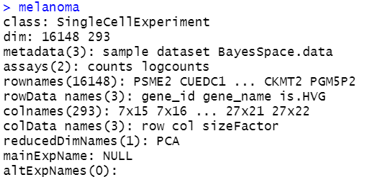
1. Load dataset
1. Load data
2. Preprocessing
3. Feature selection / Dimension reduction
4. Clustering
5. Annotation
Explore overall data
melanoma
With your raw data, gray boxed parts will not appear. These will be added after preprocessing.

Slide 26
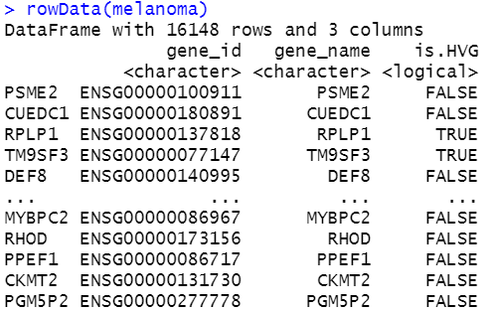
1. Load dataset
1. Load data
2. Preprocessing
3. Feature selection / Dimension reduction
4. Clustering
5. Annotation
Explore Row data
melanoma
rowData(melanoma)
With your raw data, gray boxed part will not appear. This will be added after preprocessing.

Slide 27
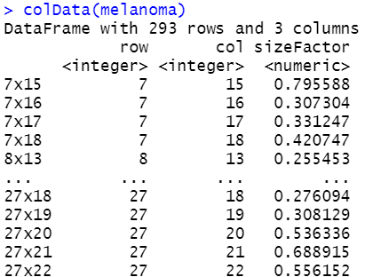
1. Load dataset
1. Load data
2. Preprocessing
3. Feature selection / Dimension reduction
4. Clustering
5. Annotation
Explore Col data
melanoma
colData(melanoma)
For 10X Visium data, colData will have 6 columns
: spot, in_tissue, row, col, imagerow,
imagecol

Slide 28
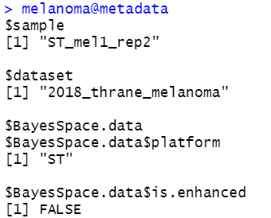
2. Preprocessing
1. Load data
2. Preprocessing
3. Feature selection / Dimension reduction
4. Clustering
5. Annotation
Add metadata
metadata(melanoma)$BayesSpace.data = list()
metadata(melanoma)$BayesSpace.data$platform = "ST”
metadata(melanoma)$BayesSpace.data$is.enhanced = FALSE

Slide 29
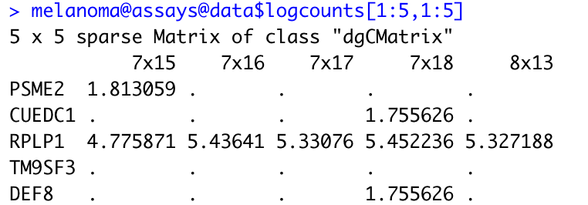
2. Preprocessing
1. Load data
2. Preprocessing
3. Feature selection / Dimension reduction
4. Clustering
5. Annotation
Log normalize
melanoma = logNormCounts(melanoma)
melanoma@assays@data$logcounts[1:10,1:10]
Normalized count = log((counts/librarysizefactor) + 1)
Librarysizefactor = total sum of counts per cell

Slide 30
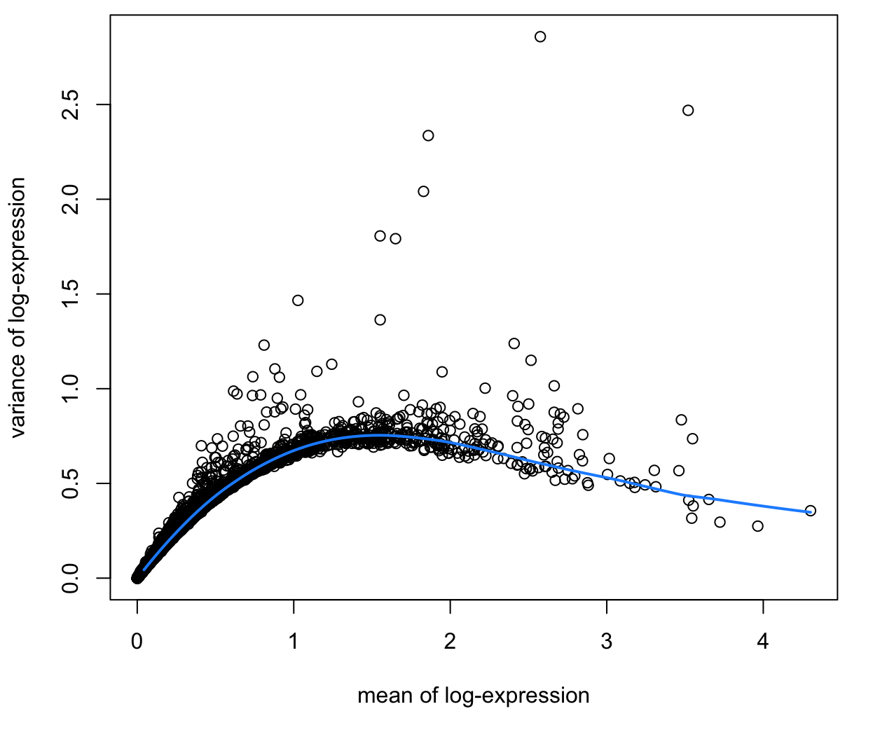
3. Feature selection and Dimension reduction
1. Load data
2. Preprocessing
3. Feature selection / Dimension reduction
4. Clustering
5. Annotation
Feature selection
dec = scran::modelGeneVar(melanoma, assay.type=“logcounts”)
top = scran::getTopHVGs(melanoma, n=2000)
1. Model the trend for variance against the mean with all genes 2. Rank genes with residual from the trend
3. Select Top N genes as HVG

Slide 31
3. Feature selection and Dimension reduction
1. Load data
2. Preprocessing
3. Feature selection / Dimension reduction
4. Clustering
5. Annotation
Dimension reduction - PCA
melanoma = scater::runPCA(melanoma, subset_row = top,ncomponents = 50)
Max
Gene C
Gene B
Min
Gene A
Max
Gene B
Gene A
Min
Gene A
Max

Slide 32
3. Feature selection and Dimension reduction
1. Load data
2. Preprocessing
3. Feature selection / Dimension reduction
4. Clustering
5. Annotation
Preprocessing, Feature selection, Dimension reduction at once
melanoma = spatialPreprocess(melanoma, platform="ST", n.PCs=50, n.HVGs=2000, log.normalize=TRUE)

Slide 33
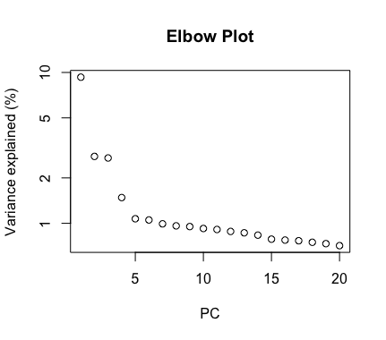
4. Clustering
1. Load data
2. Preprocessing
3. Feature selection / Dimension reduction
4. Clustering
5. Annotation
Select number of PCs to use
percent.var = attr(reducedDim(melanoma), "percentVar")
plot(percent.var[1:20], log="y", xlab="PC", ylab="Variance explained (%)", main = 'Elbow Plot’)
d = 7
Select N around the elbow

Slide 34
BayesSpace algorithm
1. Load data
2. Preprocessing
3. Feature selection / Dimension reduction
4. Clustering
5. Annotation
1. Initial labeling with non-spatial clustering method ex) mclust (Follows Mixture of Gaussian distribution)
2. Calculate the P(red) for ★ spot
Metropolis–Hastings algorithm
3. Considering neighboring spots label and label of ★ at present, with certain function,
calculate P(green), P(blue) for ★ spot
4. If P(green) > P(red) or P(blue) > P(red) update the label for ★ spot, if P(red) > P(green) & P(blue)
5. Repeat step 2~4 for set iteration
Zhao E, Stone MR, Ren X, et al. Spatial transcriptomics at subspot resolution with BayesSpace. Nat Biotechnol. 2021;39(11):1375-1384. doi:10.1038/s41587-021-00935-2

Slide 35
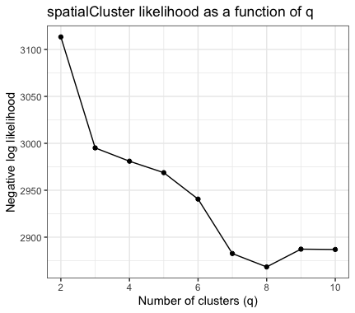
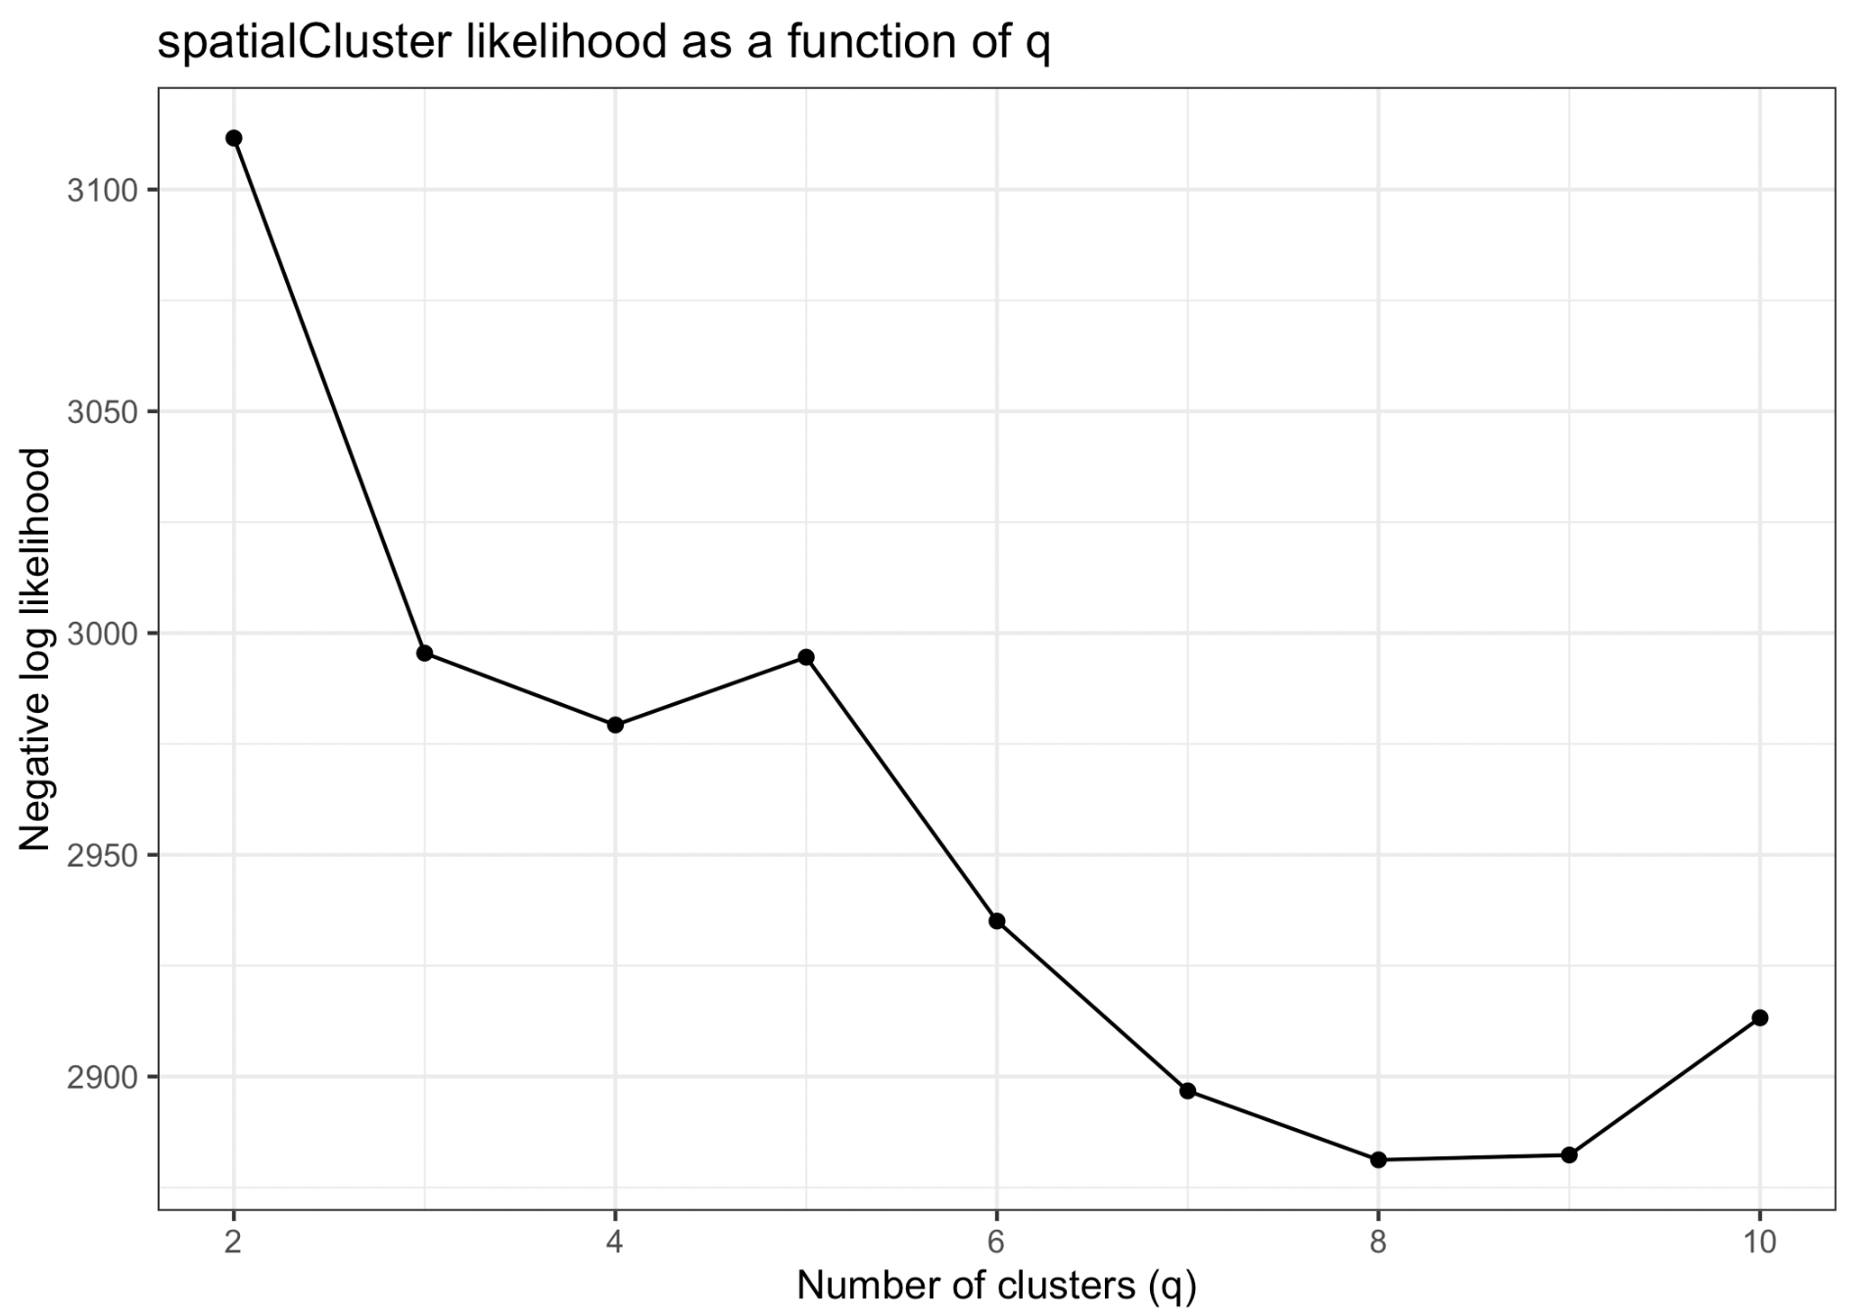
4. Clustering
1. Load data
2. Preprocessing
3. Feature selection / Dimension reduction
4. Clustering
5. Annotation
Select number of clusters to generate
melanoma = qTune(melanoma, qs=seq(2, 10), platform="ST",d=d)
qPlot(melanoma)
q = 4
Select N around the elbow
Tutorial’s plot

Slide 36
4. Clustering
1. Load data
2. Preprocessing
3. Feature selection / Dimension reduction
4. Clustering
5. Annotation
Clustering with BayesSpace
melanoma = spatialCluster(melanoma, q=q, d=d, gamma=2,
platform="ST", nrep=10000,
save.chain=TRUE)
palette = c("purple", "red", "blue", "yellow", "darkblue")
clusterPlot(melanoma, palette=palette, color="black", size=0.1) +labs(title="BayesSpace")
saveRDS(melanoma,'melanoma.rds')

Slide 37
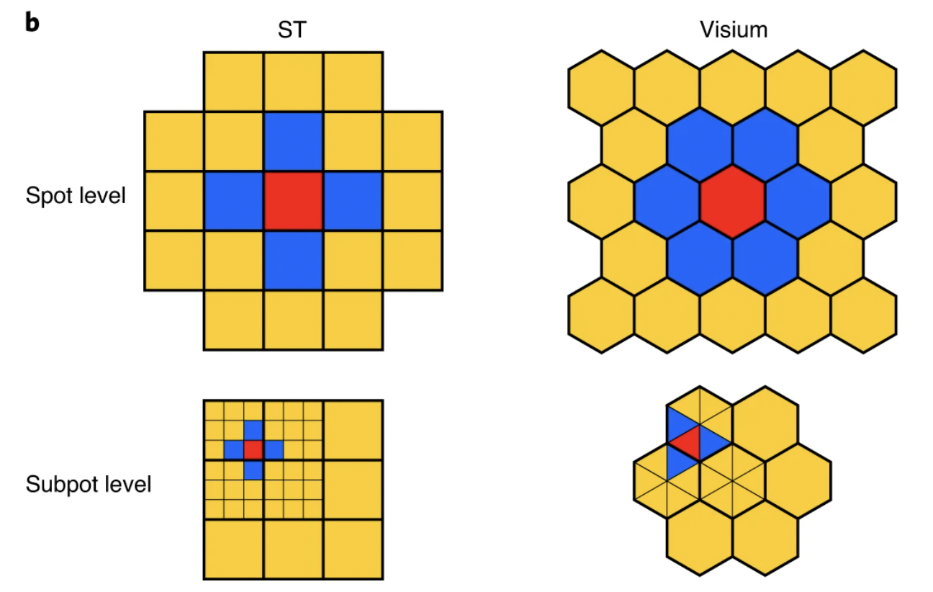
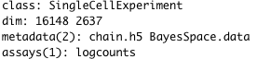
4. Clustering
1. Load data
2. Preprocessing
3. Feature selection / Dimension reduction
4. Clustering
5. Annotation
Enhancing resolution (1/2)
melanoma.enhanced = spatialEnhance(melanoma, q=q, d=d, platform="ST", gamma=2, nrep=200000, verbose=TRUE, save.chain=TRUE, jitter_scale=3.5, jitter_prior=0.3)
melannoma.enhanced = readRDS(url(“https://parkjooyoung99.github.io/KOGO_2023/data/
KOGO_2023_spatial_transcriptomics_melanoma_enhanced_object.rds”))
melanoma.enhanced
melanoma.enhanced
melanoma

Slide 38
4. Clustering
1. Load data
2. Preprocessing
3. Feature selection / Dimension reduction
4. Clustering
5. Annotation
Enhancing resolution (2/2)
clusterPlot(melanoma.enhanced, palette=palette, color="black", size=0.1) +labs(title="BayesSpace")

Slide 39
5. Annotation
1. Load data
2. Preprocessing
3. Feature selection / Dimension reduction
4. Clustering
5. Annotation
Define marker genes for plotting
markers = list()
markers[["Tumor"]] = c("PMEL")
markers[["Fibroblast"]] = c("COL1A1")
markers[["Macrophage"]] = c("CD14", "FCGR1A", "FCGR1B")
markers[["B-cell"]] = c("CD19", "MS4A1")
markers[["T-cell"]] = c("CD2", "CD3D", "CD3E", "CD3G", "CD7")
sum_counts = function(sce, features) {
if (length(features) > 1) {
colSums(logcounts(sce)[features, ])
} else {
logcounts(sce)[features, ]
}
}
spot_expr = purrr::map(markers, function(xs) sum_counts(melanoma, xs))
enhanced_expr = purrr::map(markers, function(xs) sum_counts(melanoma.enhanced, xs))
plot_expression = function(sce, expr, title){
featurePlot(sce, expr, color=NA) + viridis::scale_fill_viridis(option="A")+
labs(title=title, fill="Log-normalized\nexpression")
}
plot_expression_comparison = function(cell_type){
spot.plot = plot_expression(melanoma, spot_expr[[cell_type]],"Spot")
enhanced.plot = plot_expression(melanoma.enhanced, enhanced_expr[[cell_type]],"Enhanced")
spot.plot + enhanced.plot) +
plot_annotation(title=cell_type,
theme=theme(plot.title=element_text(size=18)))
}

Slide 40
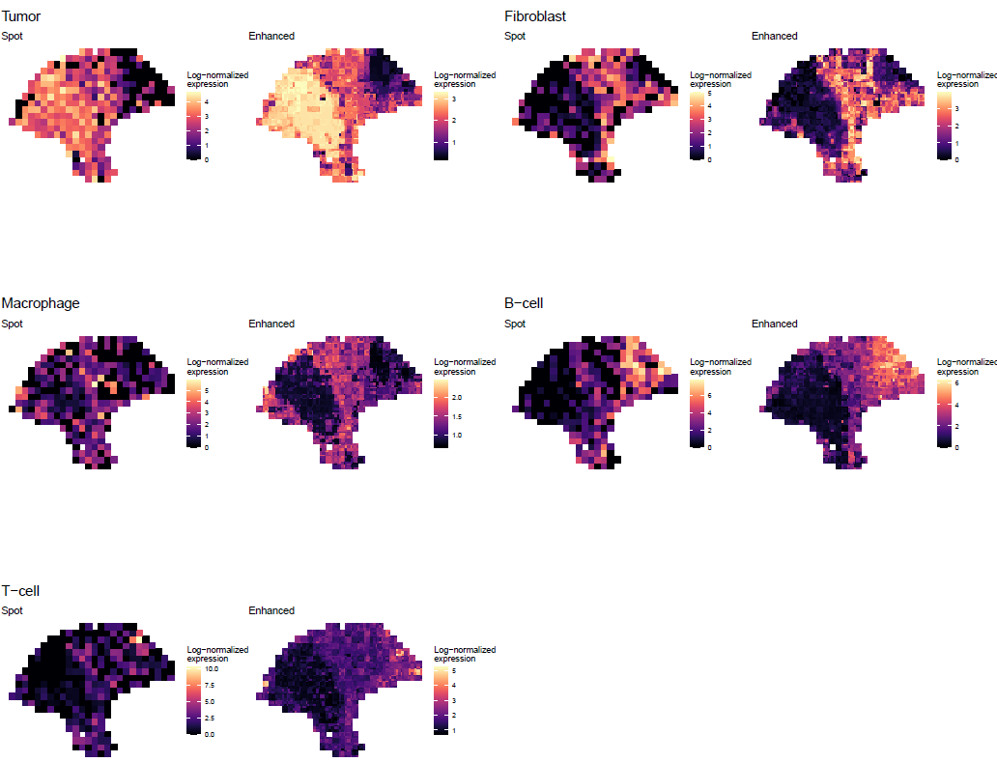
5. Annotation
1. Load data
2. Preprocessing
3. Feature selection / Dimension reduction
4. Clustering
5. Annotation
Rough cell type check
hvgs = top[grep("^RP[LS]", top, invert=TRUE)]
melanoma.enhanced = enhanceFeatures(melanoma.enhanced, melanoma, model="xgboost", feature_names=hvgs, nrounds=0)
melanoma.enhanced = readRDS(url("https://parkjooyoung99.github.io/KOGO_2023/data/KOGO_2023_spatial_transcriptomics_melanoma_enhancedfeature_object.rds"))
For each spot, linear model lm(gene ~ PCs) is fitted and supspots gene expression is predicted with subspots PC
p1 = plot_expression_comparison("Tumor")
p2 = plot_expression_comparison("Fibroblast")
p3 = plot_expression_comparison("Macrophage")
p4 = plot_expression_comparison("B-cell")
p5 = plot_expression_comparison("T-cell")
cowplot::plot_grid(p1,p2,p3,p4,p5, ncol=2)

Slide 41
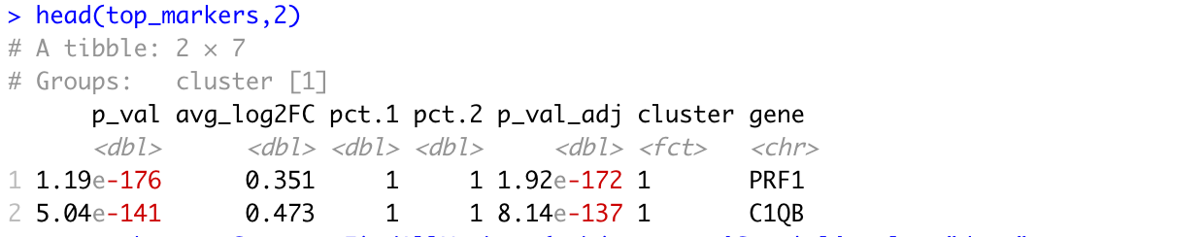
5. Annotation
1. Load data
2. Preprocessing
3. Feature selection / Dimension reduction
4. Clustering
5. Annotation
Find Marker genes for each cluster
sobj = Seurat::CreateSeuratObject(counts=logcounts(melanoma.enhanced),
assay='Spatial’,
meta.data=as.data.frame(colData(melanoma.enhanced)))
sobj = Seurat::SetIdent(sobj, value = "spatial.cluster")
sobj@assays$Spatial@scale.data =
sobj@assays$Spatial@data %>% as.matrix %>% t %>% scale %>% t
top_markers = Seurat::FindAllMarkers(sobj, assay='Spatial', slot='data’,
group.by='spatial.cluster', only.pos=TRUE) %>% group_by(cluster)
%>% top_n(5, avg_log2FC)
head(top_markers,2)

Slide 42
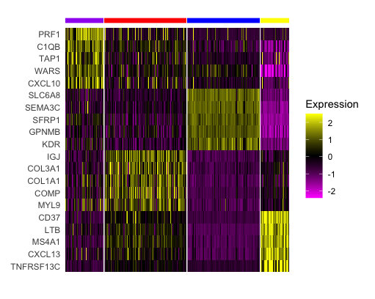
5. Annotation
1. Load data
2. Preprocessing
3. Feature selection / Dimension reduction
4. Clustering
5. Annotation
Visualize marker genes expression with heatmap
Seurat::DoHeatmap(sobj,
features = top_markers$gene, slot='scale.data’,
group.by = "spatial.cluster", group.colors=palette,
angle=0, size=4, label = FALSE, raster=FALSE) + guides(col = FALSE)

Slide 43
1. Load data
2. Preprocessing
3. Feature selection / Dimension reduction
4. Clustering
5. Annotation
5. Annotation
Annotate spots for enhanced object
coldata = colData(melanoma.enhanced)
coldata$spatial.cluster.annotation = ifelse(coldata$spatial.cluster == 1, 'Macrophage',ifelse(coldata$spatial.cluster == 2,'Fibroblasts',ifelse(coldata$spatial.cluster == 3, 'Tumor','B cell’)))
coldata$spatial.cluster.annotation = factor(coldata$spatial.cluster.annotation , levels = c('Macrophage','Fibroblasts','Tumor','B cell'))
colData(melanoma.enhanced)= coldata
clusterPlot(melanoma.enhanced, palette=palette,
color="black", size=0.1,
label = "spatial.cluster.annotation") +
labs(title="Annotation")
saveRDS(melanoma.enhanced,
'melanoma_enhanced.rds')

Slide 44
5. Annotation
1. Load data
2. Preprocessing
3. Feature selection / Dimension reduction
4. Clustering
5. Annotation
Annotate spots for melanoma object
coldata = colData(melanoma)
coldata$spatial.cluster.annotation = ifelse(coldata$spatial.cluster == 1, 'Macrophage',ifelse(coldata$spatial.cluster == 2,'Fibroblasts',ifelse(coldata$spatial.cluster == 3, 'Tumor','B cell’)))
coldata$spatial.cluster.annotation = factor(coldata$spatial.cluster.annotation , levels = c('Macrophage','Fibroblasts','Tumor','B cell'))
colData(melanoma)= coldata
clusterPlot(melanoma, palette=palette,
color="black", size=0.1,
label = "spatial.cluster.annotation") +
labs(title="Annotation")
saveRDS(melanoma, 'melanoma.rds')

Slide 45
Cell-cell interaction - CellChat
4

Slide 46
What is CellChat?
BayesSpace is an useful tool to quantitatively infer and analyze intercellular communication networks from single-cell RNA-sequencing data and spatial transcriptomics data.
Requires gene expression and spatial location data of spots/cells as the user input and models the probability of cell-cell communication by integrating gene expression with spatial distance as well as prior knowledge of the interactions between signaling ligands, receptors and their cofactors.
JIN, Suoqin, et al. Inference and analysis of cell-cell communication using CellChat. Nature communications, 2021, 12.1: 1-20.
https://htmlpreview.github.io/?https://github.com/sqjin/CellChat/blob/master/tutorial/CellChat_analysis_of_spatial_imaging_data.html

Slide 47
Dataset Description
For convenience, we will be using a recently released dataset of sagital mouse brain slices generated using the Visium v1 chemistry. There are two serial anterior sections, and two (matched) serial posterior sections.
Biological annotations of spots (i.e., cell group information) are predicted using Seurat (https://satijalab.org/seurat/articles/spatial_vignette.html).
https://www.10xgenomics.com/resources/datasets/mouse-brain-serial-section-1-sagittal-anterior-1-standard-1-0-0

Slide 48
0. Load packages in current R environment
invisible(lapply(c(‘CellChat’, ‘patchwork’), function(x) library(x, character.only=TRUE)))
options(stringsAsFactors = FALSE)
set.seed(1234)

Slide 49
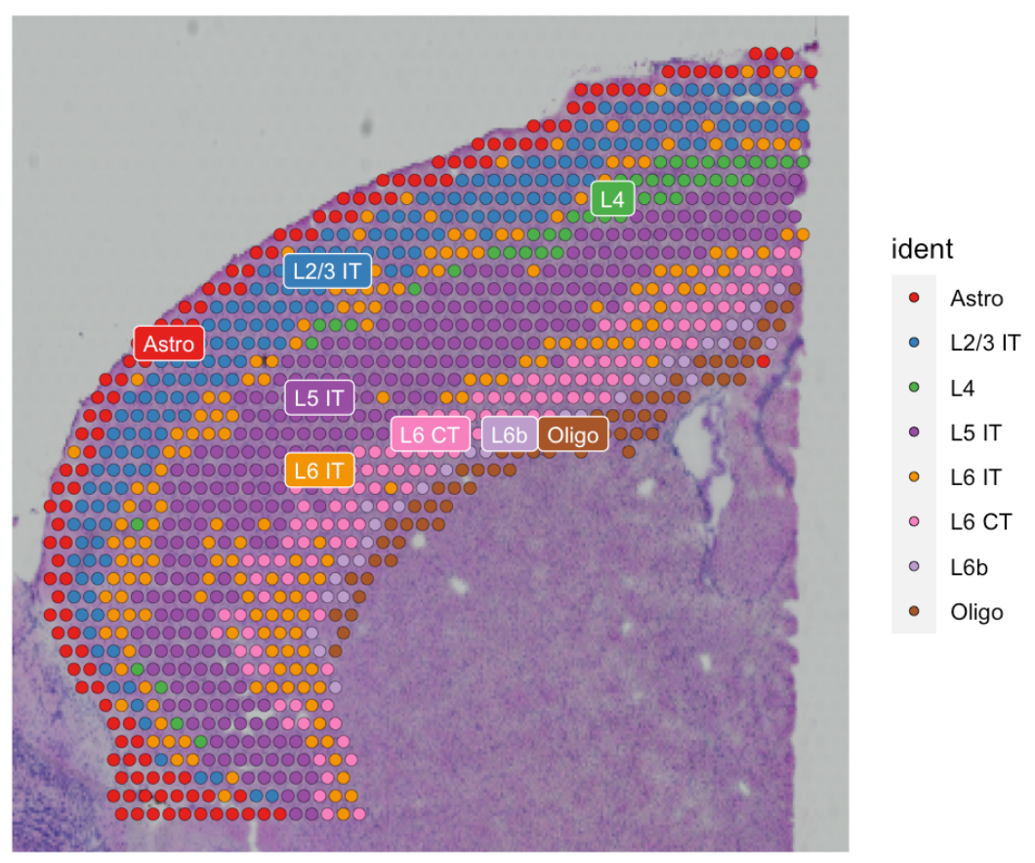
1. Load dataset
1. Load data
2. Preprocessing
3. Infer cell-cell communication network
4. Visualization
5. Find ligand-receptor pairs
Load data
visium.brain = readRDS(url("https://parkjooyoung99.github.io/KOGO_2023/data/KOGO_2023_spatial_transcriptomics_cortex_object.rds"))
visium.brain$manual_annotation = factor(visium.brain$manual_annotation, levels=c('Astro', 'L2/3 IT', 'L4', 'L5 IT','L6 IT', 'L6 CT', 'L6b', 'Oligo’))
Idents(visium.brain) = visium.brain$manual_annotation
colors = scPalette(nlevels(visium.brain))
names(colors) = c('Astro', 'L2/3 IT', 'L4', 'L5 IT','L6 IT', 'L6 CT', 'L6b', 'Oligo’)
SpatialDimPlot(visium.brain, label = T, label.size = 3, cols = colors)

Slide 50
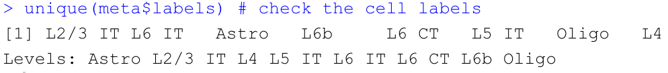
1. Load dataset
1. Load data
2. Preprocessing
3. Infer cell-cell communication network
4. Visualization
5. Find ligand-receptor pairs
Prepare input data for CellChat analysis
data.input = GetAssayData(visium.brain, slot = "data", assay = "SCT")
meta = data.frame(labels = Idents(visium.brain), row.names = names(Idents(visium.brain)))
unique(meta$labels) # check the cell labels

Slide 51
1. Load dataset
1. Load data
2. Preprocessing
3. Infer cell-cell communication network
4. Visualization
5. Find ligand-receptor pairs
Load spatial imaging information
spatial.locs = GetTissueCoordinates(visium.brain, scale = NULL, cols = c("imagerow", "imagecol"))
scale.factors = jsonlite::fromJSON(txt = url('https://parkjooyoung99.github.io/KOGO_2023/data/scalefactors_json.json'))
scale.factors = list(spot.diameter=65, spot=scale.factors$spot_diameter_fullres,
fiducial = scale.factors$fiducial_diameter_fullres,
hires = scale.factors$tissue_hires_scalef,
lowres = scale.factors$tissue_lowres_scalef
)

Slide 52
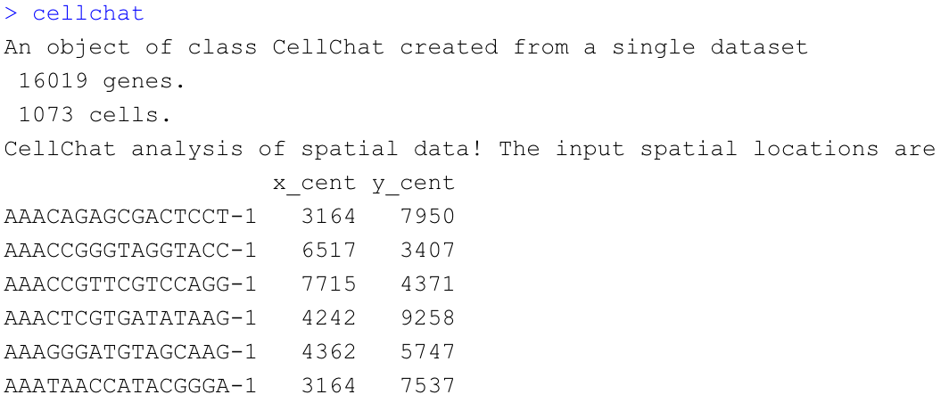
1. Load dataset
1. Load data
2. Preprocessing
3. Infer cell-cell communication network
4. Visualization
5. Find ligand-receptor pairs
Create a CellChat object
cellchat = createCellChat(object = data.input, meta = meta, group.by = "labels",
datatype = "spatial", coordinates = spatial.locs, scale.factors = scale.factors)
cellchat

Slide 53
1. Load dataset
1. Load data
2. Preprocessing
3. Infer cell-cell communication network
4. Visualization
5. Find ligand-receptor pairs
Set the ligand-receptor interaction database
CellChatDB = CellChatDB.mouse
cellchat@DB = CellChatDB

Slide 54
2. Preprocessing
1. Load data
2. Preprocessing
3. Infer cell-cell communication network
4. Visualization
5. Find ligand-receptor pairs
Preprocessing the expression data for cell-cell communication analysis
cellchat = subsetData(cellchat)
future::plan("multiprocess", workers = 4) # do parallel
cellchat = identifyOverExpressedGenes(cellchat)
cellchat = identifyOverExpressedInteractions(cellchat)
subsetdata() : subset the expression data of signaling genes for saving computation cost
Identify over-expressed ligands or receptors in one cell group
Identify over-expressed ligand-receptor interactions if either ligand or receptor is over-expressed.

Slide 55
3. Inference of cell-cell communication network
1. Load data
2. Preprocessing
3. Infer cell-cell communication network
4. Visualization
5. Find ligand-receptor pairs
Compute the communication probability and infer cellular communication network
cellchat = computeCommunProb(cellchat, type = "truncatedMean", trim = 0.1,
distance.use = TRUE, interaction.length = 200,
scale.distance = 0.01)
# read RDS file if computeCommunProb() takes too much time (optional)
cellchat = readRDS(url("https://parkjooyoung99.github.io/KOGO_2023/data/KOGO_2023_spatial_transcriptomics_cortex_cellchat_computeCommunProb_object.rds"))
cellchat = filterCommunication(cellchat, min.cells = 10)
Infers the biologically significant cell-cell communication by assigning each interaction with a probability value and performing a permutation test.
Models the probability of cell-cell communication by integrating gene expression with spatial locations as well as prior known knowledge of the interactions between signaling ligands, receptors and their cofactors using the law of mass action.

Slide 56
3. Inference of cell-cell communication network
1. Load data
2. Preprocessing
3. Infer cell-cell communication network
4. Visualization
5. Find ligand-receptor pairs
Infer the cell-cell communication at a signaling pathway level
cellchat = computeCommunProbPathway(cellchat)
Computes the communication probability on signaling pathway level by summarizing the communication probabilities of all ligands-receptors interactions associated with each signaling pathway
The inferred intercellular communication network of each ligand-receptor pair and each signaling pathway is stored in the slot ‘net’ and ‘netP’, respectively.

Slide 57
3. Inference of cell-cell communication network
1. Load data
2. Preprocessing
3. Infer cell-cell communication network
4. Visualization
5. Find ligand-receptor pairs
Calculate the aggregated cell-cell communication network
cellchat = aggregateNet(cellchat)
Calculate the aggregated cell-cell communication network by counting the number of links or summarizing the communication probability. USER can also calculate the aggregated network among a subset of cell groups by setting sources.use and targets.use.

Slide 58
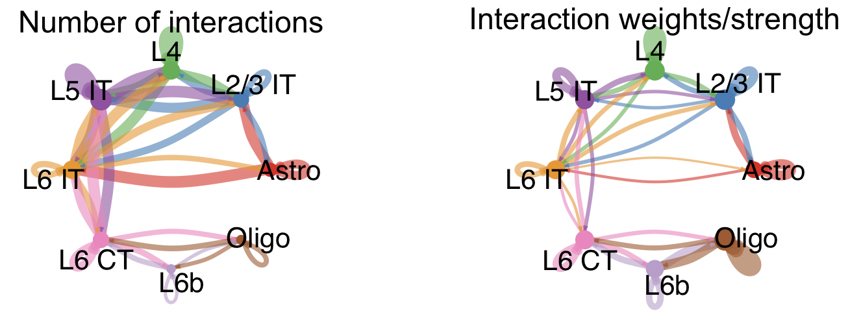
3. Inference of cell-cell communication network
1. Load data
2. Preprocessing
3. Infer cell-cell communication network
4. Visualization
5. Find ligand-receptor pairs
Visualization of the aggregated cell-cell communication network
groupSize = as.numeric(table(cellchat@idents))
par(mfrow = c(1,2), xpd=TRUE)
netVisual_circle(cellchat@net$count, vertex.weight = rowSums(cellchat@net$count), weight.scale = T, label.edge= F, title.name = "Number of interactions")
netVisual_circle(cellchat@net$weight, vertex.weight = rowSums(cellchat@net$weight), weight.scale = T, label.edge= F, title.name = "Interaction weights/strength")

Slide 59
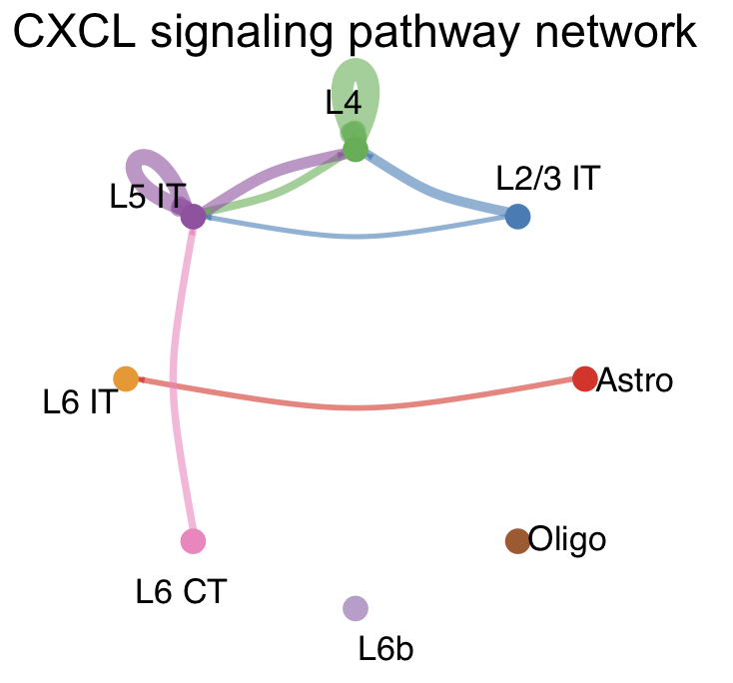
4. Visualization of cell-cell communication network
1. Load data
2. Preprocessing
3. Infer cell-cell communication network
4. Visualization
5. Find ligand-receptor pairs
Circle Plot
pathways.show = c("CXCL")
par(mfrow=c(1,1))
netVisual_aggregate(cellchat, signaling = pathways.show, layout = "circle")

Slide 60
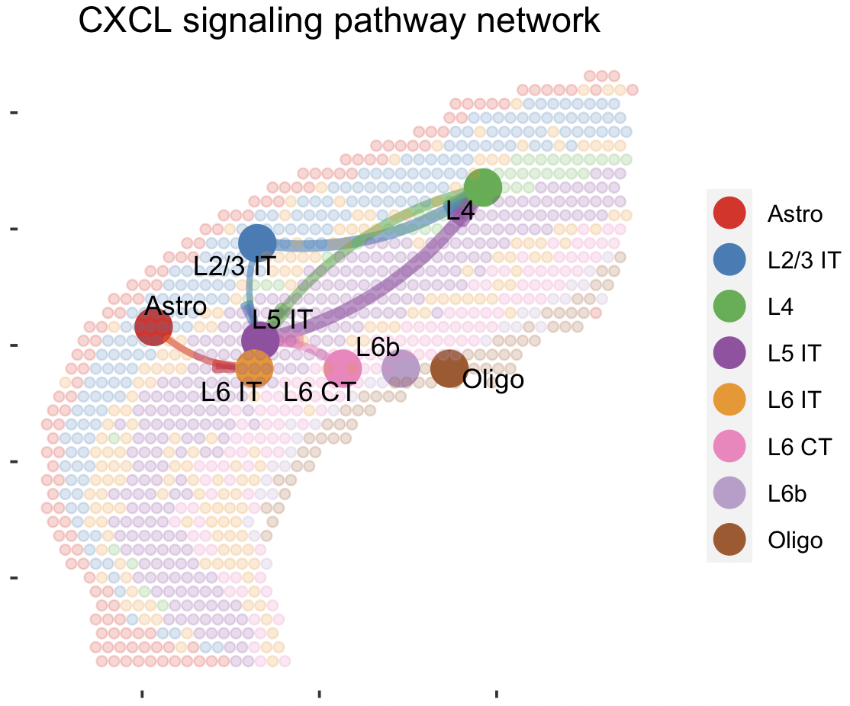
4. Visualization of cell-cell communication network
1. Load data
2. Preprocessing
3. Infer cell-cell communication network
4. Visualization
5. Find ligand-receptor pairs
Spatial Plot
par(mfrow=c(1,1))
netVisual_aggregate(cellchat, signaling = pathways.show, layout = "spatial", edge.width.max = 2, vertex.size.max = 1, alpha.image = 0.2, vertex.label.cex = 3.5)
Visualization information on the spatial imaging

Slide 61
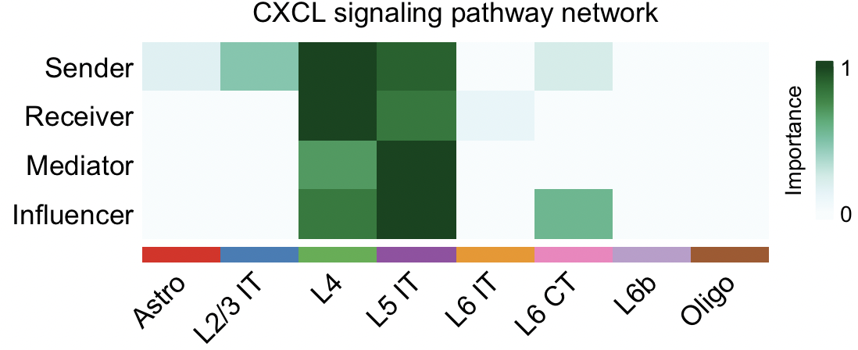
4. Visualization of cell-cell communication network
1. Load data
2. Preprocessing
3. Infer cell-cell communication network
4. Visualization
5. Find ligand-receptor pairs
Compute the network centrality scores
cellchat = netAnalysis_computeCentrality(cellchat, slot.name = "netP")
par(mfrow=c(1,1))
netAnalysis_signalingRole_network(cellchat, signaling = pathways.show, width = 8, height = 2.5, font.size = 10)
'netP’: the inferred intercellular communication network of signaling pathways
Visualize the computed centrality scores using heatmap, allowing ready identification of major signaling roles of cell groups

Slide 62
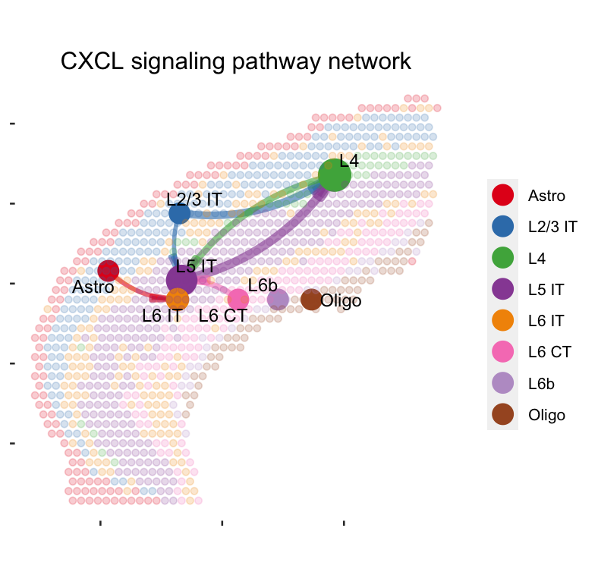
4. Visualization of cell-cell communication network
1. Load data
2. Preprocessing
3. Infer cell-cell communication network
4. Visualization
5. Find ligand-receptor pairs
Spatial Plot
par(mfrow=c(1,1))
netVisual_aggregate(cellchat, signaling = pathways.show, layout = "spatial", edge.width.max = 2, alpha.image = 0.2, vertex.weight = "incoming", vertex.size.max = 3, vertex.label.cex = 3.5)
Visualization information on the spatial imaging
Bigger circle indicates larger incoming signaling

Slide 63
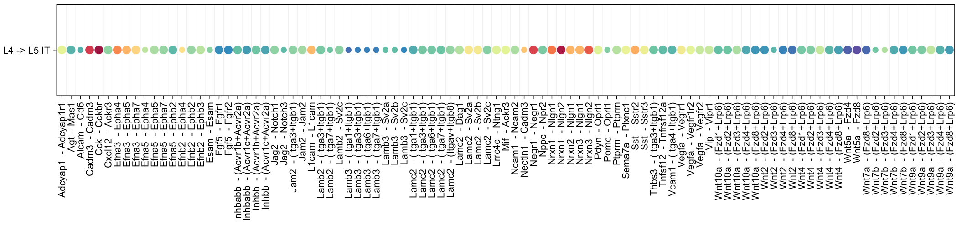
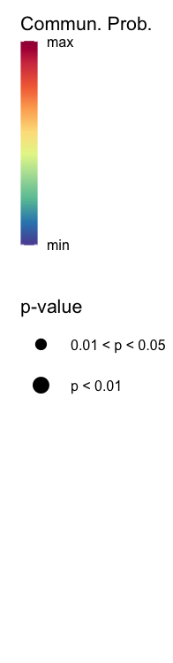
5. Find ligand-receptor pairs
1. Load data
2. Preprocessing
3. Infer cell-cell communication network
4. Visualization
5. Find ligand-receptor pairs
Identify ligand-receptor pairs associated with CXCL pathway
CellChat::netVisual_bubble(cellchat, sources.use = c(3), targets.use =c(4), remove.isolate = FALSE, angle.x = 45,thresh = 0.05)
Levels | Labels
1 | Astro
2 | L2/3 IT
3 | L4
4 | L5 IT
5 | L6 IT
6 | L6 CT
7 | L6b
8 | Oligo
Receptor and ligand pair associated with CXCL signaling

Slide 64
Summary
Use SpaceRanger to generate a gene-spot matrix file from 10X Genomics Visium sequence data (FASTQ files)
Install Space Ranger
Run spaceranger count command
Load a Visium dataset as a SinglecellExperiment
Clustering Analysis - BayesSpace
Load data and explore SinglecellExperiment object
Pre-processing (Log-normalization)
Feature selection / Dimension reduction with PCA
Clustering with enhancing resolution methods and annotate each spatial cluster with marker genes
Cell-cell interaction - CellChat
Load data and create CellChat object
Pre-processing the expression data for the cell-cell communication analysis
Compute the communication probability and infer the cellular communication network
Visualization of the cell-cell communication network with circle plot and spatial plot

Slide 65
Q & A

